Slide 1
Graded Automation
Using Conformal Prediction to Safely Deploy AI Tools in Medical Coding
Christopher Snyder, MD PhD

Slide 2
Disclosure
In compliance with the requirements of the Continuing Medical Education (CME) accrediting body, I hereby declare that I have no financial relationships or affiliations with commercial interests to disclose.

Slide 3

The Future of AI in Medicine
Promising
Unclear

Slide 4







Medical Coding
.gov
Essential
Labor Intensive
Worse with time
Coding

Slide 5
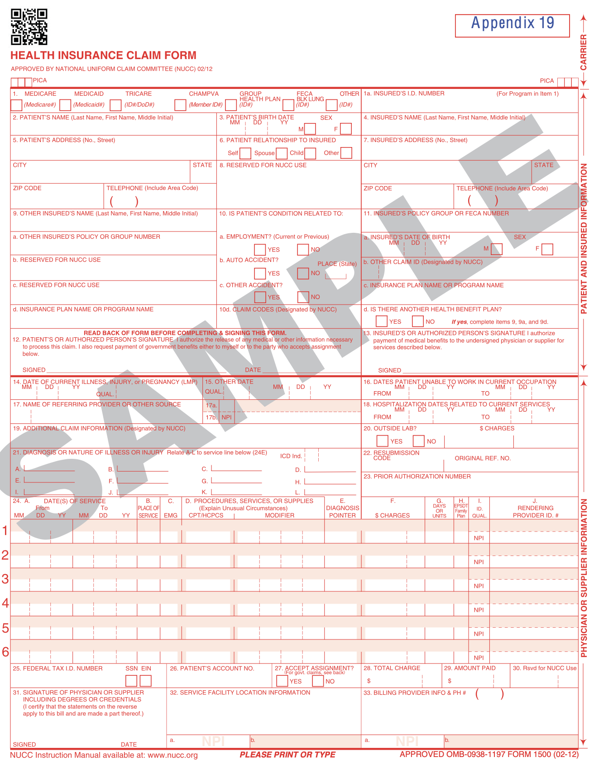
Medical Coding
.gov
Itemized Claim
Coding
Clinical Diagnosis : ”The patient is a 79-year-old woman with history of CML..."
Gross Description : ”Specimens are received in two formalin containers..."
Final Diagnosis : "Bone marrow, right…CML, chronic phase-No excess blasts..."
Pathology Report

Slide 6
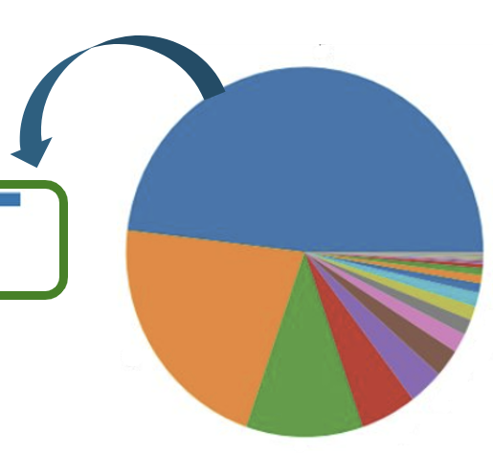
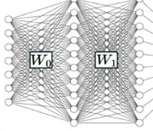
START:
Can A Computer Do It?
50k Reports
88305 – Level IV Gross/Micro
88307 – Level V Gross/Micro
88304 – Level III Gross/Micro
85060 – Blood Smear: BJH Interpretation and Report
85097 – Bone Marrow Smear: Interpretation and Report
88309 – Level VI Gross/Micro
CPT Codes
88305 – Level IV Gross/Micro​
88307 – Level V Gross/Micro​
88304 – Level III Gross/Micro​
85060 – Blood Smear
Report LLM Model Prediction Classes
Required Model Accuracy ~99%
Notes:
1 sentence – picks highest score

Slide 7



Result 1: No, AI Cannot Easily Code Reports
Fine Tuning
BERT LLM
95% Accuracy
Training Data
Prior work reaches similar conclusions [1]
What does this mean for the future of AI in Pathology (Report Coding)?
[1] Soroush et al. Large Language Models are Poor Medical Coders. NEJM 2024.
Notes:
**which model
Perhaps could be helpful to, on this slide,
explicitly say "single best guess" (that requires review 100% of the time.
I believe this or something similar helps to transition and make the next slide seem less busy.

Slide 8
Is this True?
Minimum Acceptable
Error Rate
95 < 99% Accuracy
0% Work Reduction
% Work Reduction?
YOU ARE HERE
(Verifying CPT Codes is No Easier than Coding from Scratch)
Model Reliability
Notes:
Binary — Is AI Ready?
- AI Model Quality is not a barrier to Deploying AI Models today.
- Safe processes can be built (inefficiency) with
An Allegory for AI Application
Always
No assumptions about data distribution
No assumptions about underlying model
Samples should be i.i.d.

Slide 9
What if We Think Outside the Box?
Are AI Processes Limited by AI Models?

Slide 10
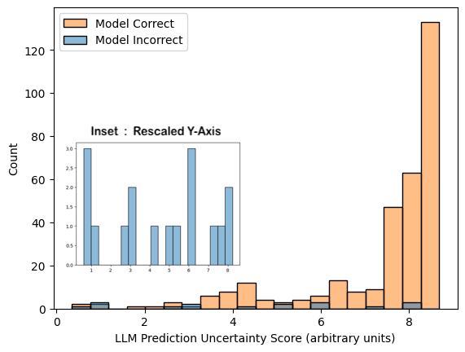
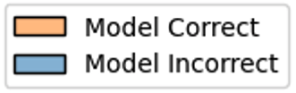
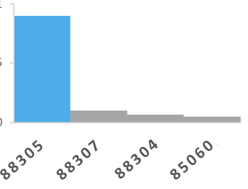


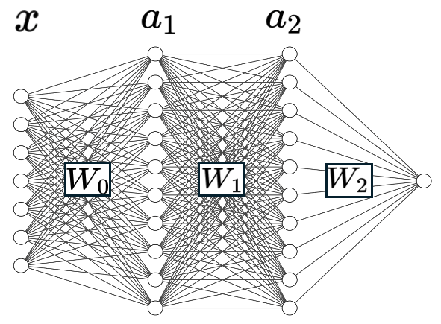
Magnitude Predictive of Correctness
x
Result 1
Result 2: The LLM Knows When it Doesn’t Know
Estimated Correctness, Log-odds
→ Delegation Thresholds can be Calibrated to Improve Performance

Slide 11




Conformal Prediction
An Established Technology
Any Model
Conformal Model
Conformal Prediction
,
,
Result : | Single Output
Performance : | Variable
Deployment : | “All Or Nothing”
Result : | Confidence Set
Performance : | User-Specified
Deployment : | Can be Triaged
[2] Angelopoulos, A. A Gentle Introduction to Conformal Prediction and Distribution-Free Uncertainty Quantiﬁcation. 2023.
[2] Angelopoulos & Bates.
A Gentle Introduction to Conformal Prediction and Distribution-Free Uncertainty Quantiﬁcation. 2023.
Notes:
** Expand on title
Differential Delegation

Slide 12

Application of Conformal Prediction to CPT Coding:
Accept
77%
Review
, ,...
Model
95 % | Accuracy
0 % | Abstain
Conformal Prediction Application
Process
99 % | Accuracy
23 % | Abstain
Notes:
Link to sankey diag
https://tinyurl.com/3dcuw4nv

Slide 13

Significance of This Work
Minimum Acceptable
Error Rate
Conventional Wisdom
Our Contribution
% Automation
Model Reliability

Slide 14
Significance of This Work
Minimum Acceptable
Error Rate
Conventional Wisdom
Our Contribution
Graded Automation
% Automation
Nod to ACGME—
“Graded Responsibility”
gradual increases in “trainee” autonomy with improvement
Model Reliability

Slide 15

Acknowledgements and Thanks
Pathology Informatics
Dr. Victor Brodsky
Medical Coding Team
Amanda Martsolf
Kelly Morgan

Slide 16
Automation is Not the End Goal
“Softening” Existing
Hard Cutoffs
Graded Automation
% Automation
Model Reliability
Notes:
**Tell audience what you want us to take home

Slide 17
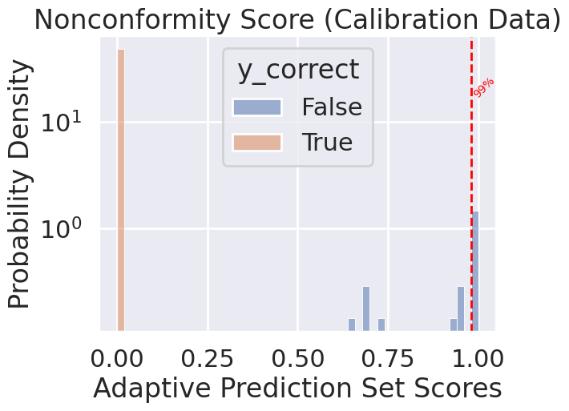


A Reference Interval for Hallucination
Plan: Identify all possible alternate CPT predictions within normal ai variation as measured by non-conformity score on calibration data
Calibration Data
,
,
99%-tile
Nonconformity
Probability Density
p-value<0.01 for any CPT code to deviate from predictions by at least this much
Counts
Nonconformity Score

Slide 18
Appendix: Result 4
Clinically Meaningful Uncertainty
Case Review | A { III, V } | B { III, IV }
Situation | “gallbladder” & “Liver” | “… ‘Mitrofanoff stoma polyp’…”
Background | Merits Both Code III and IV | Merits either III or IV; depends on Polyp Site: Nasal(III) or GI (IV)
Interpretation | Appropriate Uncertainty: Report Contains Multiple Codes | Appropriate Uncertainty: Insufficient Evidence to Distinguish Further

